Slide 1


Welcome to the
2025 PTA Annual
General Meeting
Forest Heights Academy

Slide 2
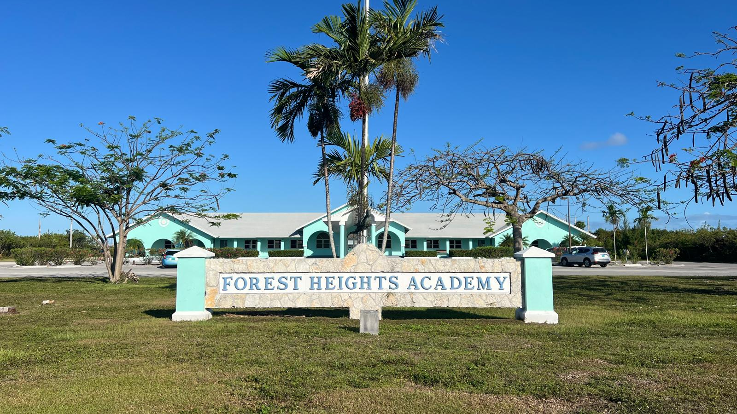

Slide 3
1. WelcomE- Mr. j. Richard
2. Prayer- Mrs. S. Miller
3.President’s ReporT- Ms. L. albury
4. Sports/PE report- Mrs. L. Rees
5. Principal’s Report- mr. J. Richard
6. Election of Officers
7. Designation of class reps
8. Break out sessions- GradeS 9 & 12
Agenda
Notes:
This lady has made our year great!
Executive Team for last year.
Lonnette Albury
Lydia Higgs
Sheree Wallas
Heather Johnston
Laura Albury
Amanda Sawyer
Sindy Lowe
James Richard

Slide 4
Mr. Richard’s Top 10
workING together to achieve excellence!

Slide 5
1.
Use The School Website!
www.forestheightsacademy.org

Slide 6


Slide 7
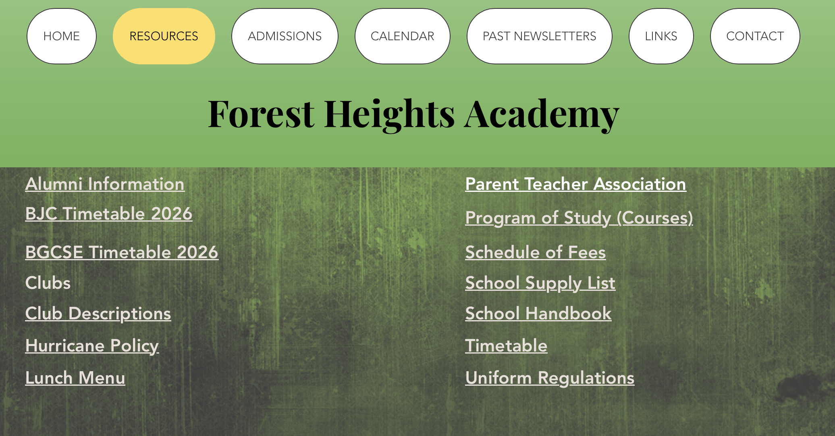

Slide 8
2.
Stay In Touch
Read the monthly newsletter- the Falcon Flyer
Check your Inbox
Join the FHA Facebook Group
Contact the teacher directly if you have questions or concerns
When visiting campus, always check in at the office FIRST
For safety, campus is closed from 8 a.m. to 3:30 p.m.

Slide 9
3.
Get to Know Ms. McDonald
  School Fees/Receipts/Statements
  Billing Questions
  Lunch Information
  Transcript Requests
  Absent student work
  Late Arrivals
  Early Pick-Ups
  Medication/Band Aids
  School Supplies
  Updated documents or emergency contacts etc.

Slide 10
3. 5
Get to Know Ms. walz
  Student issues
  Peer tutoring
  Counseling
  Life skills

Slide 11
4.
Get to know our teachers
Get to know YOUR CHILD’S teachers
Please use e-mail (not THINKWAVE, social media or whatsapp) TO CONTACT TEACHERS

Slide 12
5.
Reinforce positive behaviour
  Join us in encouraging our students to do great things!
  Free Dress Days
  Free Dress Coupons
  Merits
  Student of the Month
  Students Caught Doing Good
  Pizza and Ice Cream Parties
  Field Trips and Class Trips
  Annual awards night

Slide 13
6.
Support the school rules
Ensure that your child attends school, is on time, and is in uniform
Ensure that your child has breakfast & an SSR book everyday
Don’t send a phone, smart watch, gum, coffee, energy drink or Headphones
Medication must be given to Ms. McDonald
Labelled lunches must be brought to the office before Noon
Pick your child up promptly after school and clubs

Slide 14
6.
Support the school rules

Slide 15
7.
Work together
Bring out the best in our students
Grace period for homework (9 am)
Coursework deadlines are firm
Ensure that your child is following all uniform and jewelry rules
Pay school fees on time
Parental advisories must be signed and returned for students to attend class
Discourage the use of AI to complete work

Slide 16
7.5
Ensure your child’s file is complete- Deadline is tomorrow
Passport or Birth Certificate
Immunization Records
NIB Smart Card
Residency Permits
BJC Results
Signed Handbook Agreement
Student Accident Insurance Form
Field Trip Permission SLip
Emergency Contacts

Slide 17
8.
Remember that clubs & activities matter
  Don’t wait until Grade 12!
  Clubs have started
  Community-Based Clubs
  Church Activities
  Youth Groups
  Sports
  30 Hours of Community Service required

Slide 18
clubs
  Girl guides & ranger guides
  Crochet
  Junkanoo
  Interact
  Unite Bible Club
  Eco-Club
  Book club
  Communications club
  Speech & Debate
  Spelling

Slide 19
9.
Focus on academics
Ensure that your child completes AND turns in their homework
Stay on top of homework by signing your child’s homework book!
Use Thinkwave to monitor progress
Sign your child up for peer tutoring IF needed
Sports will only be allowed for students that are doing well academically and following the rules

Slide 20
10.
Support your PTA
We only have one meeting a year, so thank you for coming!
The Executive Team will plan the fall event and the spring raffle
Join us and volunteer for these amazing events!

Slide 21

Questions and Answers

Slide 22
Election of Officers
&
Volunteer Class Representatives
Teacher Reps:
Ms. murphy & Ms. Walz

Slide 23
Thank you for coming!
Breakout Sessions:
Grade 9 – Room 103
Grade 12 – Room 104

